Slide 1
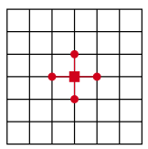




Project B: Morteza Namvar Fall 2021
Two-dimensional simplified heat equation
Numerical solution

Slide 2
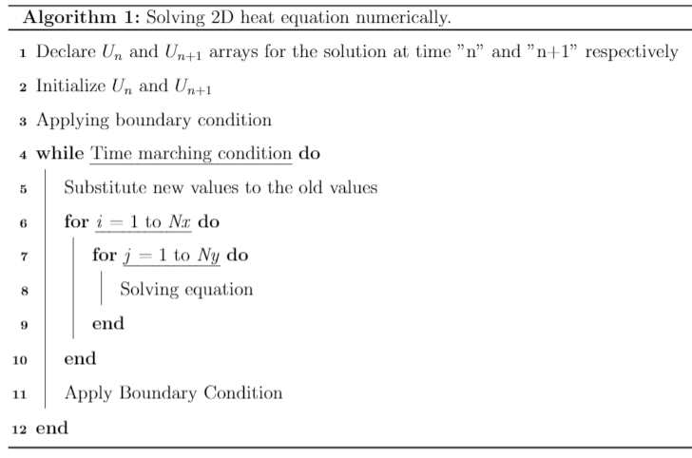
Project B: Morteza Namvar Fall 2021
Two-dimensional simplified heat equation

Slide 3
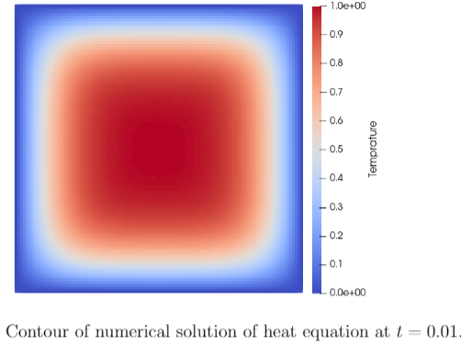
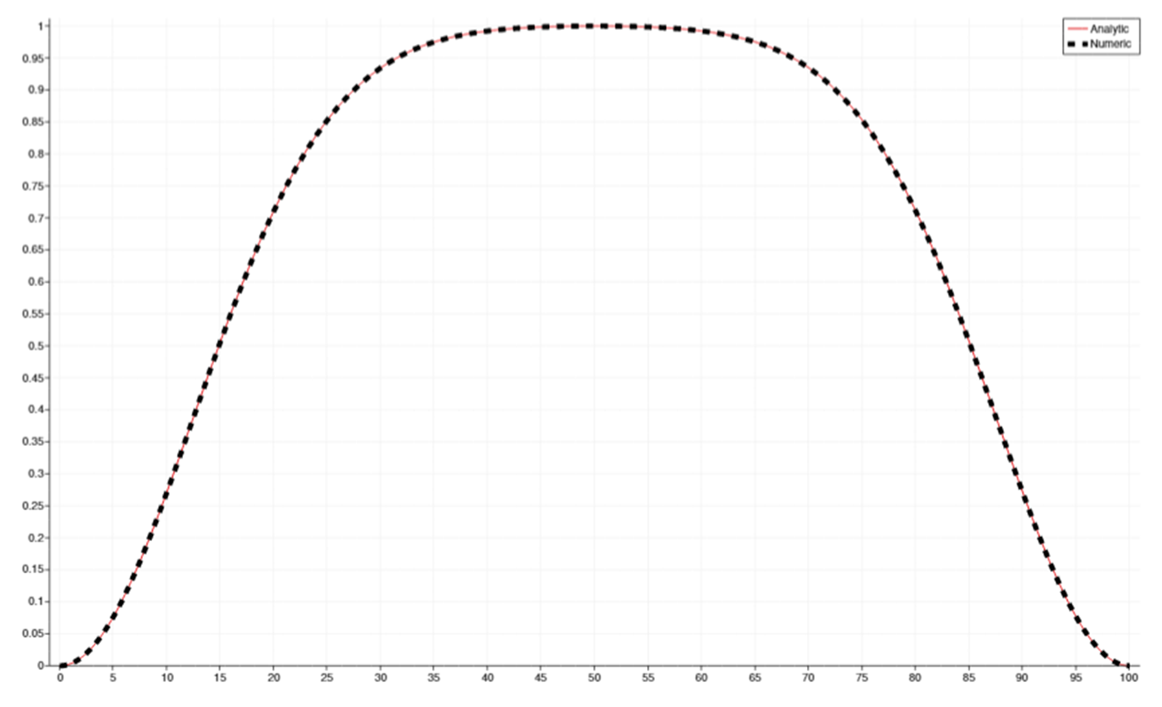
Project B: Morteza Namvar Fall 2021
Two-dimensional simplified heat equation

Slide 4
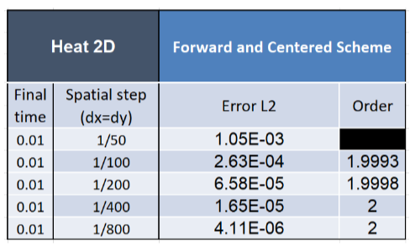
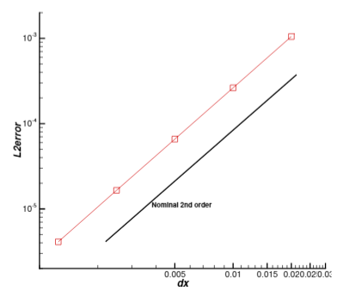
Project B: Morteza Namvar Fall 2021
Two-dimensional simplified heat equation

Slide 5
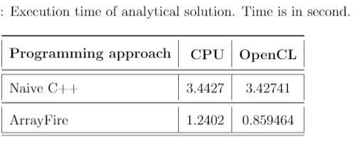
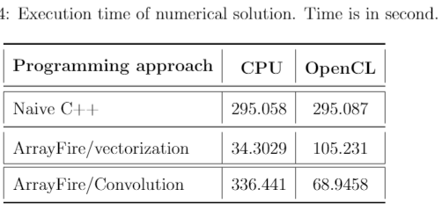
Project B: Morteza Namvar Fall 2021
Two-dimensional simplified heat equation

Slide 6
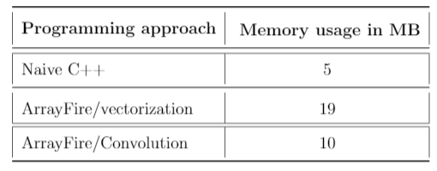
Project B: Morteza Namvar Fall 2021
Two-dimensional simplified heat equation

